Slide 1

ISE 218: Fundamentals of Information Technology Unit 4: Instruction Set Architecture
Spring 2025
Instructor: Abid Malik
co-Instructor: Xinrui Yu

Slide 2
Introduction
This Unit builds upon the ideas in Unit 3.
We will take a detailed look at different instruction formats, operand types, and memory access methods.
We will see the interrelation between machine organization and instruction formats.
This leads to a deeper understanding of computer architecture in general.

Slide 3
Instruction Formats
Instruction sets are differentiated by the following:
Number of bits per instruction.
How computations are carried out.
Number of explicit operands per instruction.
Operand location: in registers or main memory
Types of operations.
Type and size of operands.

Slide 4
Instruction Formats
Instruction set architectures are measured according to:
Main memory space occupied by a program.
Instruction complexity.
Instruction length (in bits).
Total number of instructions in the instruction set.
In designing an instruction set, consideration is given to:
Instruction length: whether short, long, or variable.
Number of operands.
Number of programmer-accessible registers.
Memory organization: whether byte- or word-addressable.

Slide 5
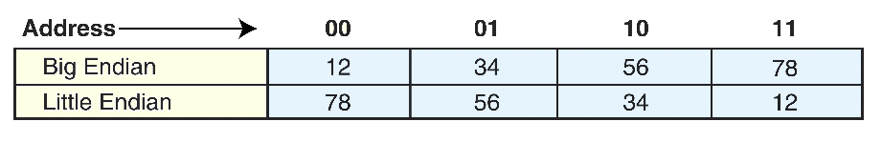
Instruction Formats
Byte ordering, or endianness, is another major architectural consideration.
If we have a two-byte integer, the integer may be stored so that the least significant byte is followed by the most significant byte or vice versa.
In little endian machines, the least significant byte is followed by the most significant byte.
Big endian machines store the most significant byte first (at the lower address).
As an example, suppose we have the hexadecimal number 0x12345678.
The big endian and small endian arrangements of the bytes are shown below.

Slide 6
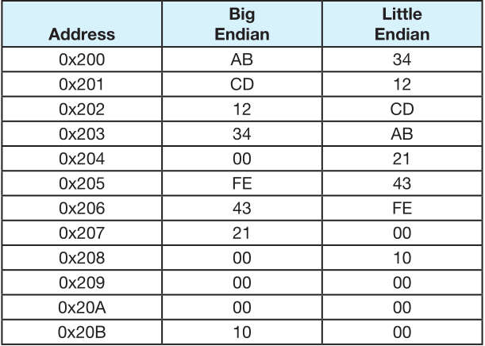
Instruction Formats
A larger example of endianness: a computer uses 32-bit integers. The values 0xABCD1234, 0x00FE4321, and 0x10 would be stored sequentially in memory, starting at address 0x200, as shown on the right.

Slide 7
Instruction Formats
Big endian:
Is more intuitive for many people.
The sign of the number can be determined by looking at the byte at address offset 0.
Strings and integers are stored in the same order.
Little endian:
Has a more natural connection with the place-values of base-2 integers.

Slide 8
Endianness: Example #1
Assume you have a byte-addressable machine that uses 32-bit integers and you are storing the hex value 3456 at address 0.
How is this value stored on a big endian machine?
Address: | 00 | 01 | 10 | 11
Bytes | 00 | 00 | 34 | 56

Slide 9
Endianness: Example #2
Assume you have a byte-addressable machine that uses 32-bit integers and you are storing the hex value 3456 at address 0.
How is this value stored on a little endian machine?
Address: | 00 | 01 | 10 | 11
Bytes: | 56 | 34 | 00 | 00

Slide 10
Endianness: Example #3
Fill in the following table to show how the given integers are represented, assuming 16 bits are used to store the values and the machine uses two’s complement notation.
Integer
Hex
4-byte big
4-byte little
endian
endian
28
001C
001C
1C00
2216
08A8
08A8
A808
-
18675
B70D
B70D
0DB7
-
12
FFF4
FFF4
F4FF
31456
7AE0
7AE0
E07A

Slide 11
Endianness: Example #4
Consider a 32-bit hexadecimal number stored in memory as shown on the right:
If the machine is big endian and uses two’s complement representation for integers, write the 32-bit integer number stored at address 100.
Answer: 2AC2081B
Address | Value
100 | 2A
101 | C2
102 | 08
103 | 1B

Slide 12
Endianness: Example #5
Consider a 32-bit hexadecimal number stored in memory as shown on the right:
If the machine is little endian and uses two’s complement representation for integers, write the 32-bit integer number stored at address 100.
Answer: 1B08C22A
Address | Value
100 | 2A
101 | C2
102 | 08
103 | 1B

Slide 13
Endianness: Example #6
The first two bytes of a 2M x 16 main memory have the following hex values:
Byte 0 is FE
Byte 1 is 01
If these bytes hold a 16-bit two’s complement integer, what is its actual decimal value if:
memory is big endian?
0xFE01 = 1111 1110 0000 0001₂ = $−51110$
memory is little endian?
0x01FE = 0000 0001 1111 1110₂ = $51010$

Slide 14
Instruction Formats
The next consideration for architecture design concerns how the CPU will store data.
We have three choices:
A stack architecture (a stack is a special kind of data structure from computer science)
An accumulator architecture (MARIE)
A general purpose register architecture (what modern computers use)
In choosing one over the other, the tradeoffs are simplicity (and cost) of hardware design with execution speed and ease of use.

Slide 15
Instruction Formats
In an accumulator architecture, one operand of a binary operation is implicitly in the accumulator.
One operand is in memory, creating lots of bus traffic.
In a general purpose register (GPR) architecture, registers can be used instead of memory.
Faster than accumulator architecture (why?)
Fewer trips to memory
Results in longer instructions (why?)
Instruction must identify which registers are involved in the computation

Slide 16
Instruction Formats
Most systems today are GPR systems.
There are three types of GPR architectures:
Memory-memory where two or three operands may be in memory.
Register-memory where at least one operand must be in a register.
Load-store where no operands may be in memory.
The number of operands and the number of available registers has a direct effect on instruction length.

Slide 17
Instruction Formats
Instruction formatting options:
Fixed length wastes space, but fast
Variable length – complex to decode, but saves space
Typical modern computers use 2-3 different instruction lengths
Common instruction formats (the word “address” on this slide only means either means a memory address or a register):
OPCODE only (zero addresses)
OPCODE + 1 Address (usually a memory address)
OPCODE + 2 Addresses (usually two registers)
OPCODE + 3 Addresses (usually registers)

Slide 18
Instruction Formats: Example #1
A computer has 32-bit instructions and 12-bit memory addresses. Suppose there are 250 two-address instructions. How many one-address instructions can be formulated?
An 8-bit opcode allows for 256 operations
250 opcodes for two-address instructions are already taken, leaving 6 opcodes for one-address instructions
Opcode (8 bits) | Address 1 (12 bits) | Address 2 (12 bits)

Slide 19
Instruction Formats: Example #2
A computer has a memory unit with 32 bits per word and has 16 general-purpose registers. The instruction set consists of 135 different operations. Some instructions have an opcode part, an address part, and a register part. Other instructions have an opcode part, and two address parts. Each instruction is stored in one word of memory.
How many bits are needed for the opcode?
The smallest power of 2 that is greater than or equal to 135 is 256, which is 2⁸. Therefore, 8 bits are needed for the opcode.

Slide 20
Instruction Formats: Example #2 (cont.)
A computer has a memory unit with 32 bits per word and has 16 general-purpose registers. The instruction set consists of 135 different operations. Some instructions have an opcode part, an address part, and a register part. Other instructions have an opcode part, and two address parts. Each instruction is stored in one word of memory.
How many bits are needed to specify a register?
There are 16 registers, so 4 bits are needed because 16 = 2⁴.

Slide 21
Instruction Formats: Example #2 (cont.)
A computer has a memory unit with 32 bits per word and has 16 general-purpose registers. The instruction set consists of 135 different operations. Some instructions have an opcode part, an address part, and a register part. Other instructions have an opcode part, and two address parts. Each instruction is stored in one word of memory.
How many bits are needed to specify a memory address?
Tricky! Some instructions require two memory addresses. We have 32 – 8 = 24 bits for memory addresses in that case. 24/2 = 12 bits per address.

Slide 22
Instruction Formats: Example #2 (cont.)
A computer has a memory unit with 32 bits per word and has 16 general-purpose registers. The instruction set consists of 135 different operations. Some instructions have an opcode part, an address part, and a register part. Other instructions have an opcode part, and two address parts. Each instruction is stored in one word of memory.
What is the maximum allowable size for memory, assuming that the memory is word-addressable?
We have 2¹² words we can address with 4 bytes per word: 2¹² $×$ 4 bytes = 2¹⁴ bytes = 16 KB

Slide 23
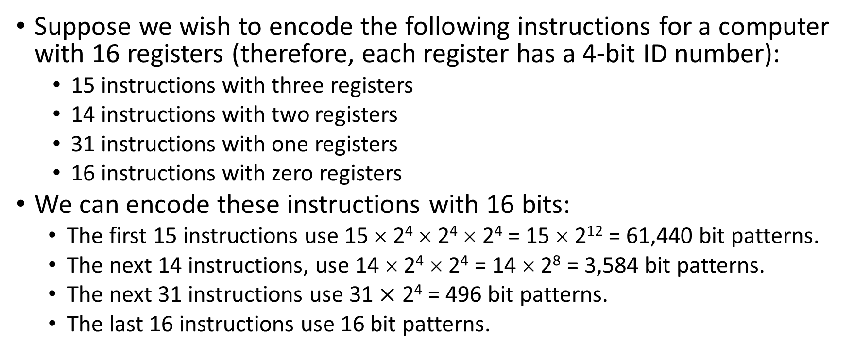
Instruction Formats: Example #3
Suppose we wish to encode the following instructions for a computer with 16 registers (therefore, each register has a 4-bit ID number):
15 instructions with three registers
14 instructions with two registers
31 instructions with one registers
16 instructions with zero registers
We can encode these instructions with 16 bits:
The first 15 instructions use 15 × 2⁴ × 2⁴ × 2⁴ = 15 × 2¹² = 61,440 bit patterns.
The next 14 instructions, use 14 × 2⁴ × 2⁴ = 14 × 2⁸ = 3,584 bit patterns.
The next 31 instructions use 31 $×$ 2⁴ = 496 bit patterns.
The last 16 instructions use 16 bit patterns.

Slide 24
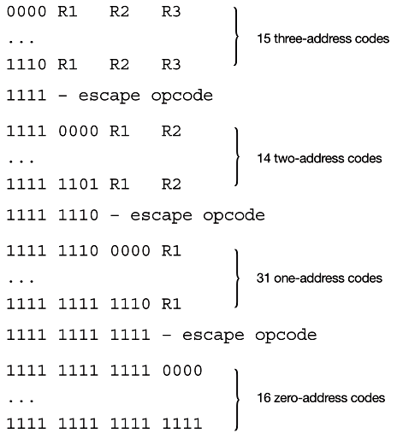
Instruction Formats: Example #3 (cont.)
A challenge: given an instruction, how can we tell what format it’s in? (4-bit, 8-bit, 12-bit, or 16-bit opcode?)
The trick is to reserve special bit patterns called escape opcodes
From our example:
15 instructions with 3 operands
14 instructions with 2 operands
31 instructions with 1 operand
16 instructions with 0 operands

Slide 25
Instruction Formats: Example #3 (cont.)
First 4 bits are 1111 → instruction has 0, 1 or 2 operands
First 8 bits are 1111 1110 → instruction has 0 or 1 operands
First 12 bits are 1111 1111 1111 → instruction has 0 operands

Slide 26
Instruction Formats: Example #4
In a computer instruction format, the instruction length is 11 bits and the size of an address field is 4 bits. Show how it would be possible to simultaneously support the following instruction formats by providing the opcode ranges for each instruction type:
5 2-address instructions
45 1-address instructions
32 0-address instructions
Answer:
000 xxxx xxxx through 100 xxxx xxxx (5 instructions)
101 is the next available prefix. Use 1010000–1011111 (16 opcodes), 1100000–1101111 (16), 1110000–1111100 (13)
111111 is the next available prefix. Use 11111100000–11111111111

Slide 27
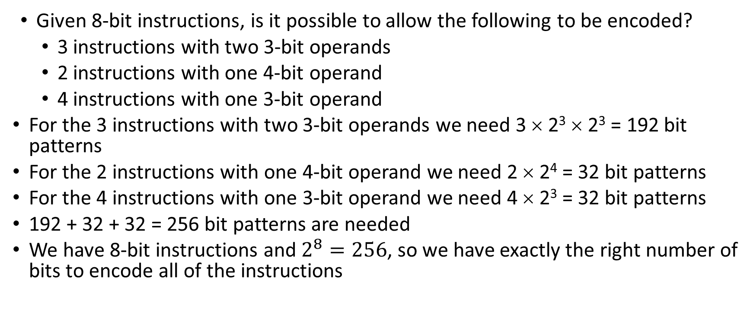
Instruction Formats: Example #5
Given 8-bit instructions, is it possible to allow the following to be encoded?
3 instructions with two 3-bit operands
2 instructions with one 4-bit operand
4 instructions with one 3-bit operand
For the 3 instructions with two 3-bit operands we need 3 × 2³ × 2³ = 192 bit patterns
For the 2 instructions with one 4-bit operand we need 2 × 2⁴ = 32 bit patterns
For the 4 instructions with one 3-bit operand we need 4 × 2³ = 32 bit patterns
192 + 32 + 32 = 256 bit patterns are needed
We have 8-bit instructions and $2^{8}=256$, so we have exactly the right number of bits to encode all of the instructions

Slide 28
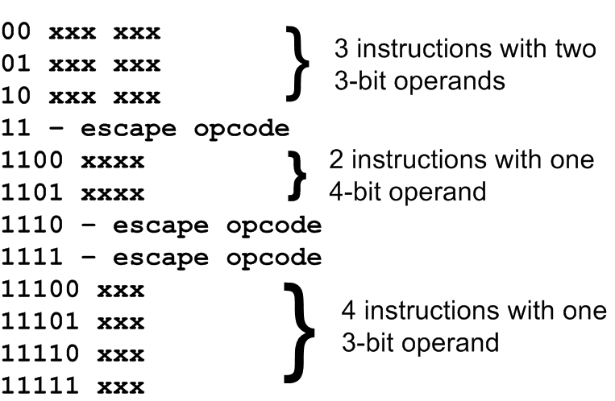
Instruction Formats: Example #5 (cont.)

Slide 29
Instruction Types
Instructions fall into several broad categories, some of which you are familiar with:
Data movement
Arithmetic
Boolean
Bit manipulation
I/O
Control transfer
Special purpose (e.g., string processing, protection, cache management, others)

Slide 30
Addressing Modes
Addressing modes specify where an operand is located.
They can specify a constant, a register, or a memory location.
The actual location of an operand is its effective address.
Certain addressing modes allow us to determine the address of an operand dynamically by performing a calculation while software is running.
Different kinds of addressing modes exist to make it easier for assembly language programmers to write software
Immediate addressing is where the data is part of the instruction, as a constant.
e.g., LOADIMMEDIATE 008 loads the numeric value 8 into the AC

Slide 31
Addressing Modes
Direct addressing is where the address of the data is given in the instruction.
e.g., LOAD 008 with direct addressing loads the value stored in memory location 8 into the AC
Register addressing is where the data is located in a register.
Same as direct addressing, except the data is located in a register (not memory)
Indirect addressing gives the address of the address of the data in the instruction. It sounds strange, but this mode can make programming easier.
e.g., LOAD 008 would mean to go to memory address 0x008 and treat the contents of that memory cell as a memory address
Suppose 0x2A0 were stored at memory address 0x008
This means that 0x2A0 is the “real” address of what we want

Slide 32
Addressing Modes: Example
For the instruction shown, what hexadecimal value is loaded into the accumulator for each addressing mode?
Memory:
Addressing Mode | Loaded into AC
Immediate
Direct
Indirect
Index | 0x700
Address | Contents
0x800 | 0x900
…
0x900 | 0x1000
…
0x1000 | 0x500
…
0x1100 | 0x600
…
0x1700 | 0x700
0x800
0x900
0x1000
IR: LOAD 800

Slide 33
Instruction Pipelining
Some CPUs divide the fetch-decode-execute cycle into smaller steps.
These smaller steps can often be executed in parallel to increase throughput.
Such parallel execution is called instruction pipelining.
Instruction pipelining provides for instruction-level parallelism (ILP)
Suppose a fetch-decode-execute cycle were broken into the following smaller steps:
1. Fetch instruction. 4. Fetch operands.
2. Decode opcode. 5. Execute instruction.
3. Calculate effective 6. Store result.
address of operands.
Suppose we have a six-stage pipeline, with stages S1 – S6 corresponding to the above six steps.

Slide 34
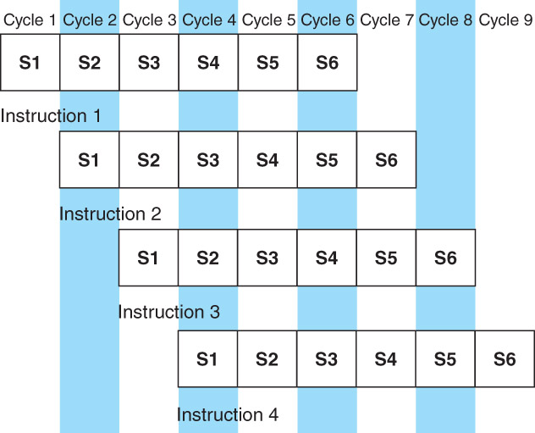
Instruction Pipelining
For every clock cycle, one small step is carried out, and the stages overlap
S1. Fetch Instruction
S2. Decode opcode
S3. Calculate Effective address of operands
S4. Fetch operands
S5. Execute
S6. Store result

Slide 35
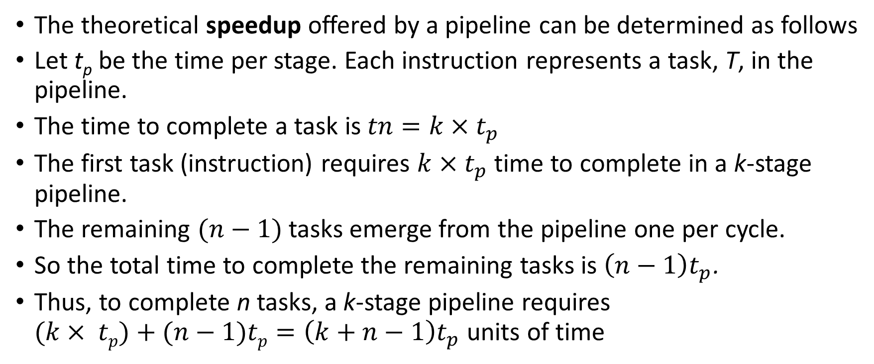
Instruction Pipelining
The theoretical speedup offered by a pipeline can be determined as follows
Let t_{p} be the time per stage. Each instruction represents a task, T, in the pipeline.
The time to complete a task is$tn=k×t_{p}$
The first task (instruction) requires $k×t_{p}$ time to complete in a k-stage pipeline.
The remaining $(n−1)$ tasks emerge from the pipeline one per cycle.
So the total time to complete the remaining tasks is $\left(n−1\right)t_{p}$.
Thus, to complete n tasks, a k-stage pipeline requires $(k× tp)+(n−1)tp=\left(k+n−1\right)t_{p}$ units of time

Slide 36
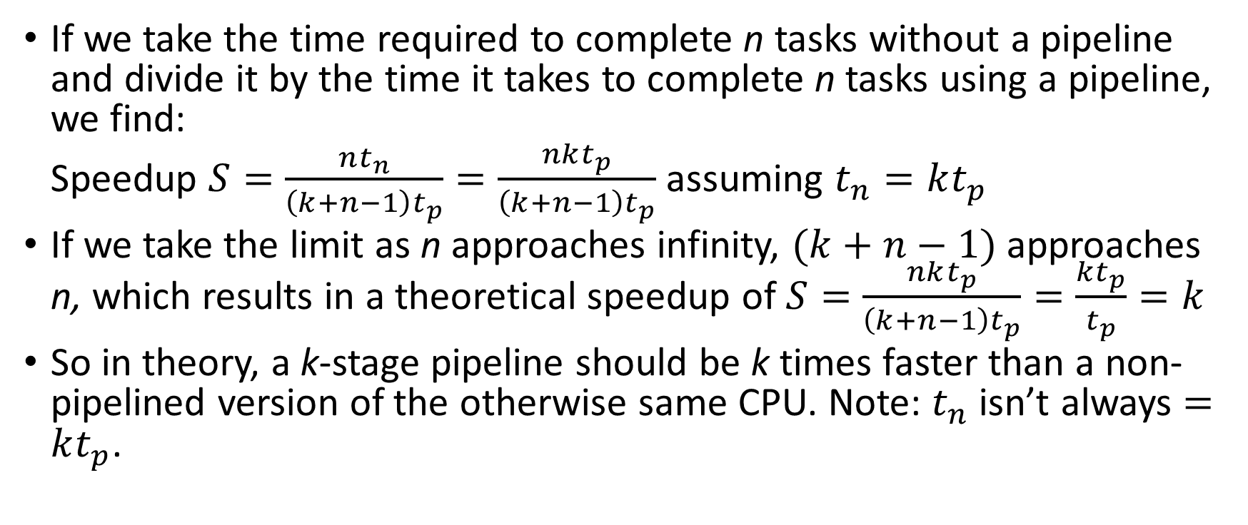
Instruction Pipelining
If we take the time required to complete n tasks without a pipeline and divide it by the time it takes to complete n tasks using a pipeline, we find:
Speedup $S=\frac{nt_{n}}{\left(k+n−1\right)t_{p}}=\frac{nkt_{p}}{\left(k+n−1\right)t_{p}}$ assuming $t_{n}=kt_{p}$
If we take the limit as n approaches infinity, $(k+n−1)$ approaches n, which results in a theoretical speedup of $S=\frac{nkt_{p}}{\left(k+n−1\right)t_{p}}=\frac{kt_{p}}{t_{p}}=k$
So in theory, a k-stage pipeline should be k times faster than a non-pipelined version of the otherwise same CPU. Note: $t_{n}$ isn’t always $=kt_{p}$.

Slide 37
Instruction Pipelining: Example
Speedup: $S=\frac{nt_{n}}{\left(k+n−1\right)t_{p}}$
A nonpipelined system takes 200 ns to process a task. The same task can be processed in a 5-segment pipeline with a clock cycle of 40 ns.
What is the speedup ratio of the pipeline for 200 tasks?
$S=\frac{nt_{n}}{\left(k+n−1\right)t_{p}}$
$=\frac{200×200ns}{\left(5+200−1\right)×40ns}$
$=\frac{40000}{204×40}≈4.9019$

Slide 38
Instruction Pipelining
Our neat equations take a number of things for granted.
First, we have to assume that the architecture supports fetching instructions and data in parallel.
Second, we assume that the pipeline can be kept filled at all times. This is not always the case. Pipeline hazards arise that cause pipeline conflicts and stalls.
An instruction pipeline may stall for any of the following reasons:
Resource conflicts: two instructions want to access memory at the same time
Data dependencies: an instruction needs to read a value from a register but the value hasn’t been written yet by some previous instruction that hasn’t finished executing yet
Conditional branching: program changes order of execution of its instructions
Some hazards can be avoided, but not all

Slide 39
Other Kinds of Pipelining
A superscalar CPU has multiple ALUs and can execute multiple executions simultaneously
It’s like having multiple instruction pipelines
Explicitly parallel instruction computers (EPIC) have very long instructions that specify multiple operations to be done in parallel
In superpipelining, a typical pipeline is made longer by breaking the stages into sub-stages so that each sub-stage takes less than one-half a clock cycle to complete
The idea is that even more instructions can be executed in parallel

Slide 40
Real-world Examples of ISAs
We return briefly to the Intel and MIPS architectures from the last Unit, using some of the ideas introduced in this chapter.
Intel introduced pipelining to its processor line with its Pentium chip.
The first Pentium had two five-stage pipelines. Each subsequent Pentium processor had a longer pipeline than its predecessor with the Pentium IV having a 24-stage pipeline.
The Itanium (IA-64) has only a 10-stage pipeline.
Intel processors support a wide array of addressing modes.
The original 8086 provided 17 ways to address memory, most of them variants on the methods presented in this Unit.
Owing to their need for backward compatibility, the Pentium chips also support these 17 addressing modes.

Slide 41
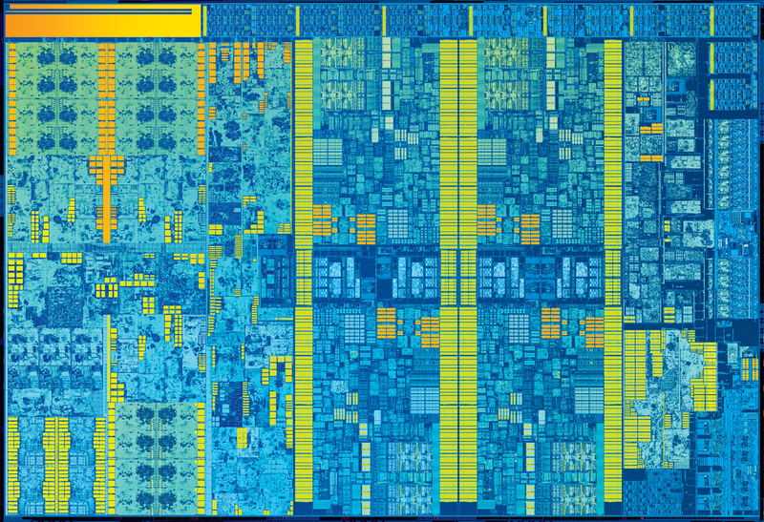
9th Generation Intel “Skylake” Quad-core CPU

Slide 42
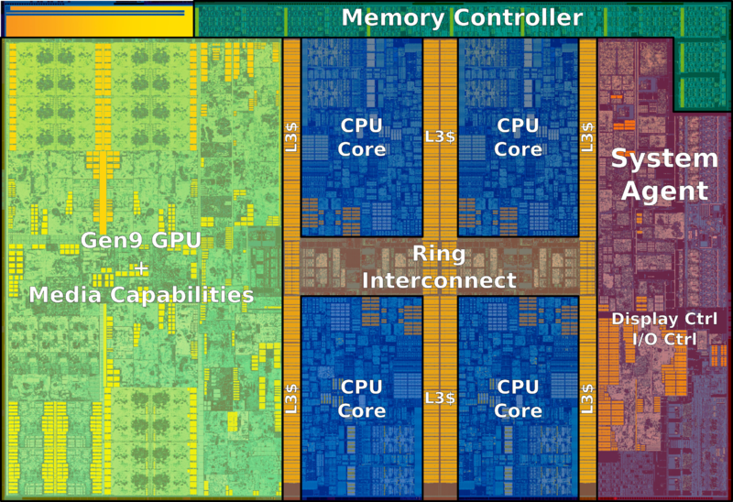
9th Generation Intel “Skylake” Quad-core CPU

Slide 43
Real-world Examples of ISAs
MIPS is an acronym for Microprocessor without Interlocked Pipeline Stages.
RISC architecture
The architecture is little endian and word-addressable with three-address, fixed-length instructions.
Like Intel, the pipeline size of the MIPS processors has grown: The R2000 and R3000 have five-stage pipelines.; the R4000 and R4400 have eight-stage pipelines.
The R10000 has three pipelines: A five-stage pipeline for integer instructions, a seven-stage pipeline for floating-point instructions, and a six-state pipeline for load/store instructions.
In all MIPS ISAs, only the load and store instructions can access memory.
The ISA uses only a few addressing modes to access data (why only a few?)

Slide 44
RISC Machines vs. CISC Machines
Simple instructions, few in number
Fixed length instructions
Complexity in compiler
Only load/store instructions access memory
Few addressing modes
Multiple register sets
Three operands per instruction
Single-cycle instructions
Highly pipelined
Many complex instructions
Variable-length instructions
Complexity in microcode
Many instructions can access memory
Many addressing modes
Single register set
One or two register operands per instruction
Multiple-cycle instructions
Less pipelined

Slide 45
Real-world Examples of ISAs
You might not have heard of ARM, but most likely you use an ARM processor every day. It is the most widely used 32-bit instruction architecture:
95%+ of smartphones,
80%+ of digital cameras
40%+ of all digital television sets
Founded in 1990, by Apple and others, ARM (Advanced RISC Machine) is now a British firm, ARM Holdings.
ARM Holdings does not manufacture these processors; it sells licenses to manufacture.

Slide 46
Real-world Examples of ISAs
ARM is a load/store architecture: all data processing must be performed on values in registers, not in memory.
It uses fixed-length, three-operand instructions and simple addressing modes
ARM processors have a minimum of a three-stage pipeline (consisting of fetch, decode, and execute).
Newer ARM processors have deeper pipelines (more stages).
ARM has 37 total registers but their visibility depends on the processor mode.
ARM allows multiple register transfers at once.
It can simultaneously load or store any subset of the 16 general-purpose registers from/to sequential memory addresses.
Most ARM instructions execute in a single cycle, provided there are no pipeline hazards or memory accesses.

